Slide 1

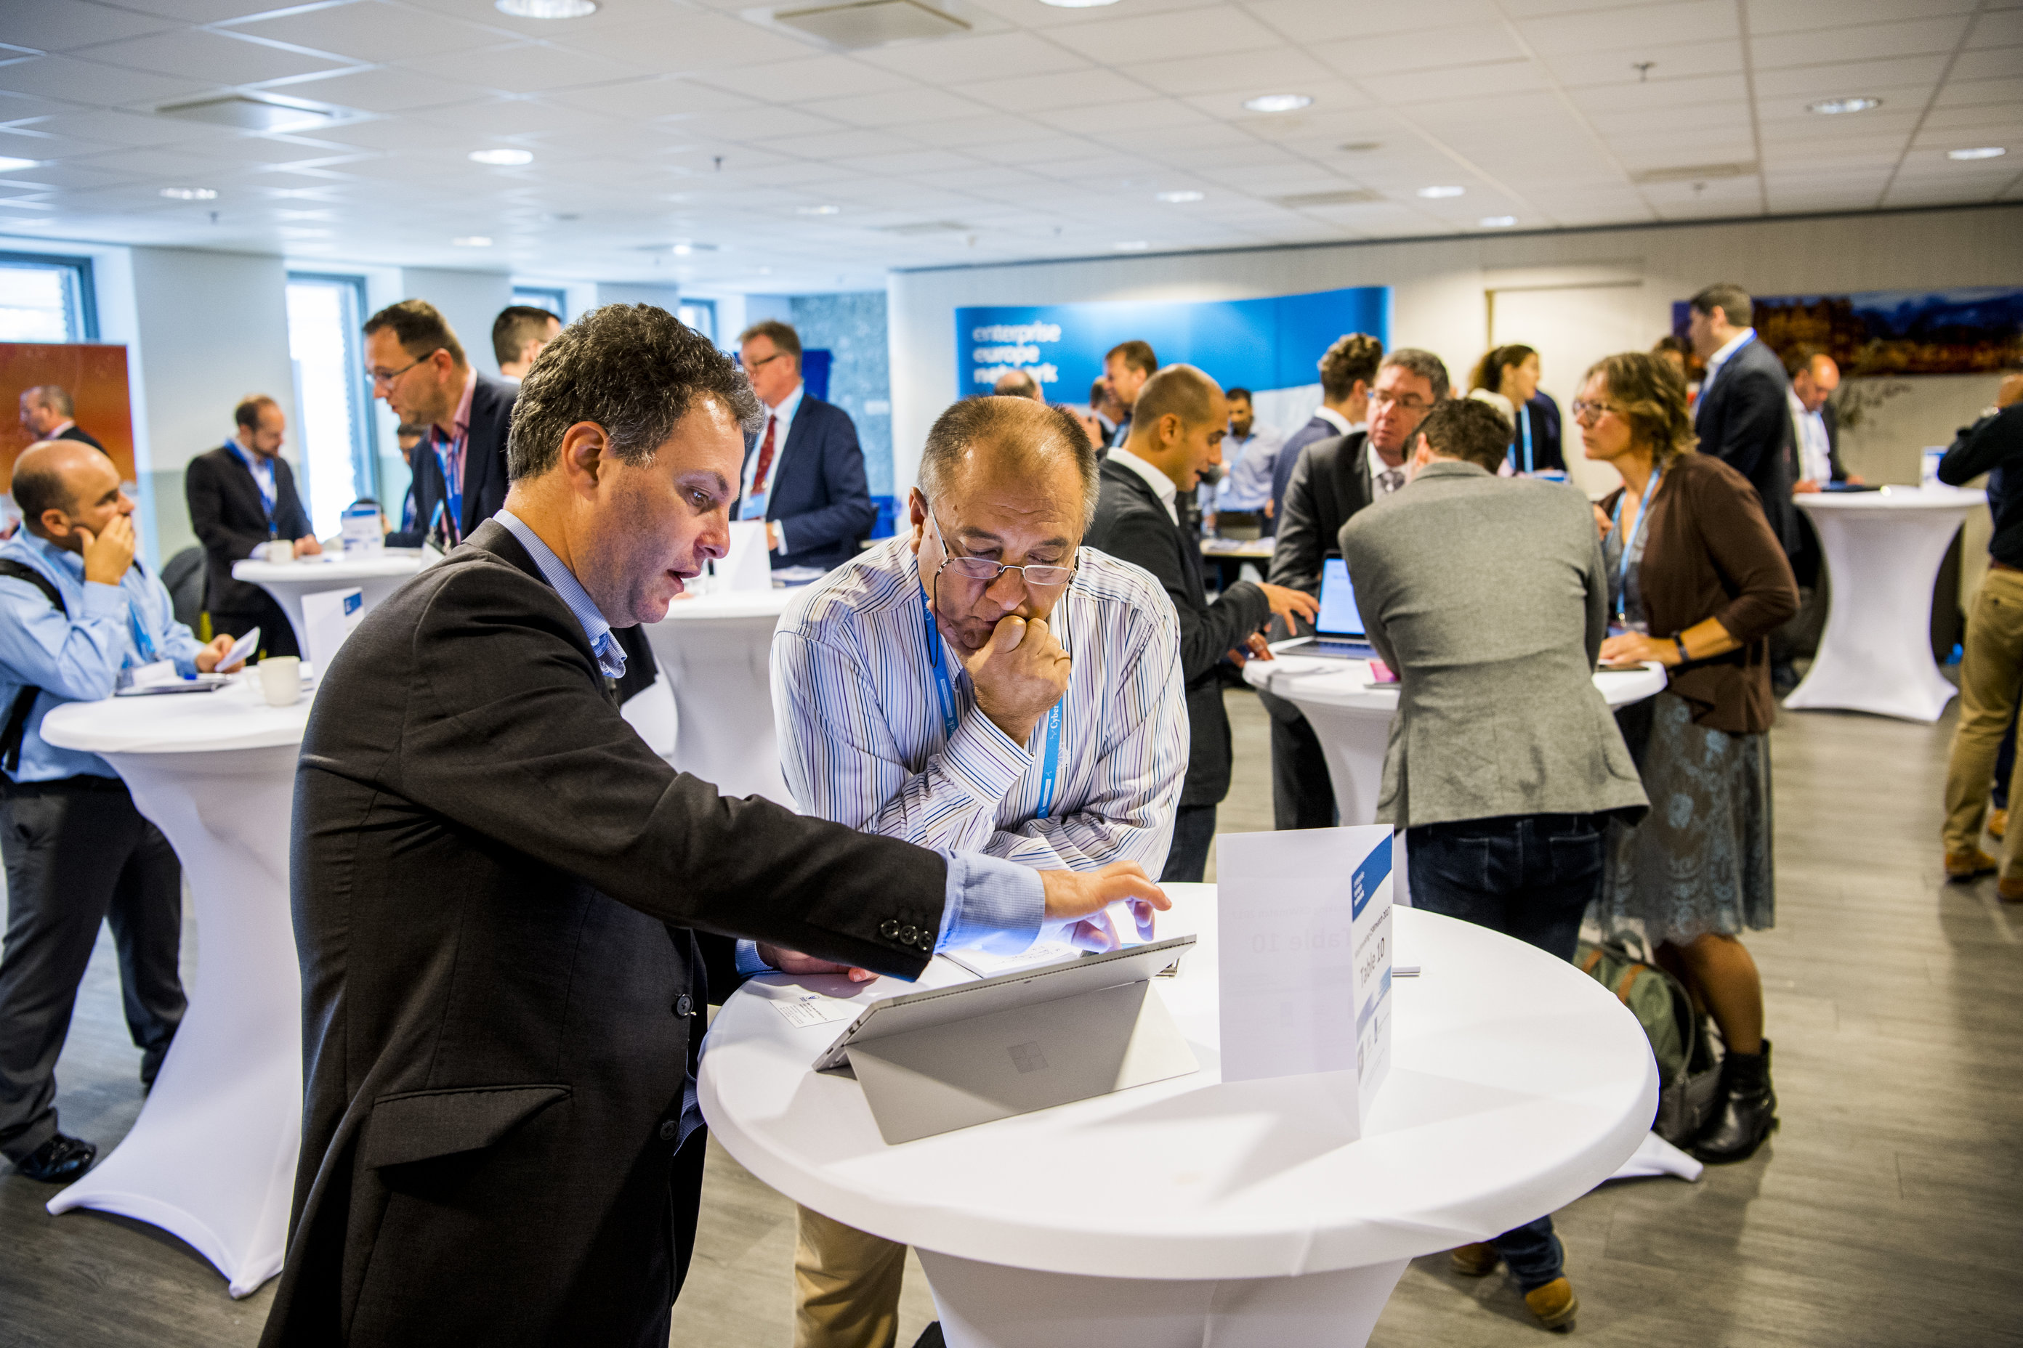



Call for Participation: CSW 2018
Join the expo!
2-5 October 2018 - The Hague – The Netherlands
The first week of October 2018 is all about cyber security in its most versatile aspects. Because of Alert Online and The One Conference, this week is the ideal moment to organise the third edition of the Cyber Security Week (CSW) in The Hague, the Netherlands. Do you want to participate in the CSW programme? Please let us know!
Call for Participation Cyber Security Week: Congress & Expo on 4-5 Oct.
If you would like to display your cyber security innovation at the Expo, please let us know by consulting the CSW coordinator via: coordination@cybersecurityweek.nl.
On the following pages you will find more information and guidelines for the CSW Expo.
Deadlines for submitting for the CSW Expo is
31 August 2018
If you are interested in sponsoring the CSW, you can also contact the CSW-coordinator.
    Agenda
2&3 Oct: The One Conference (World Forum)
2-4 Oct: CIPRE Conference & Expo (Crown Plaza)
2 Oct: NRC Live event cyber security (Diligentia)
3 Oct: Central Network Reception
4&5 Oct: CSW Conference & Expo (Fokker Term.)
4&5 Oct: CSW Matchmaking Event (Fokker Term.)
4 Oct: CSW Access to Capital Event (Fokker Term.)
5 Oct: CSW Access to Talent Event (Fokker Term.)
    Pre-registration
Interested in joining the CSW as a visitor? Pre-register via the website:
www.cybersecurityweek.nl

Slide 2
CSW Congress, Expo and Matchmaking
4 & 5 October 2018 Fokker Terminal
On 4 and 5 October, the CSW Congress and Expo will take place at the Fokker Terminal. This two-day programme consist of a matchmaking event with prearranged meetings, an exhibition, and dozens of cyber security related keynotes, breakouts and workshops. Don’t miss the opportunity to meet interesting partners and customers, and to get access to innovation, market, talent and capital.
Expo Opportunities
During the expo, many (inter)national organisations will display their innovative cyber security solutions. By participating, you will get access to extensive technology expertise and new business channels. Each day, 800 visitors are expected.
We encourage stands and pavilions at the CSW EXPO to focus on their innovation, preferably developed in collaboration with other parties. Organisations can present their innovation clustered in country pavilions.
Table Top Information Stand - €495,-
    (Incl. administration and handling fee, excl. VAT)
    The stand includes:
    2x2 Meter carpet floor
    A Table bar (80x80cm) and 2 barstools
    One power socket (max. 1000 Watt)
    Secured WiFi connection
    Listing on the official CSW website and event guide
    Lunch and coffee breaks
    Participation in Matchmaking Event
    Optional:
    Production rollup banner (85x200cm, upon delivery print file). €125,-
Exhibition Stand - €1295,-
    (Incl. administration and handling fee, excl. VAT)
    The stand includes:
    3x3 Meter carpet floor
    A table bar (80x80cm) and 2 barstools
    Blank exhibition wall
    Truss pillar with logo board and light (150x75cm)
    Two power socket (max. 2000 Watt)
    Secured Wi-Fi connection
    Listing on the official CSW website and event guide
    Lunch and coffee breaks
    Participation in Matchmaking Event
    Optional:
    Production exhibition wall print (3x2m, upon delivery print file) €300,-
    Upgrade to bigger bar table (150x90cm) €40,-
    Upgrade to wired internet connection €85,-
    Additional power socket €25,-
    TV screen hung in truss pillar (on request)
    Three-phase power (on request)
Type | Investment
Table Top Information Stand | €495,-
Exhibition Stand | €1295,-
Raw Floor Space (minimum 9 m²) | €125,- per m²
Furnished Premium Exhibition Stand (minimum 15 m²) | On request
All prices are quoted in Euros and exclusive of 21% VAT. Sponsor opportunities on request.

Slide 3
CSW Congress: Expo Opportunities
4 & 5 October 2018 Fokker Terminal
Raw Floor Space - €125,- p/m²
    (Incl. administration and handling fee, excl. VAT)
    The stand includes:
    Raw floor space to build your own pavilion
    Two power socket (max. 2000 Watt)
    Secured WiFi connection
    Listing on the official CSW website and event guide
    Lunch and coffee breaks
    Participation in Matchmaking Event
    In consultation with the CSW organisation you can bring your own stand or pavilion with a minimum of 9 m². Furniture, audio-visual accessories and other requirements can be ordered through the CSW organisation.
Furnished Premium Exhibition Stand – price upon request
    (Incl. administration and handling fee, excl. VAT)
    We offer several premium exhibition stands, or a fully customized pavilion, on request at a minimum of 15m²
    The stand includes:
    Secured Wi-Fi connection
    Listing on the official CSW website and event guide
    Lunch and coffee breaks
    Participation in Matchmaking Event
Terms and conditions
    Deadline for signing up as exhibitor is 31 August 2018
    Additional furniture and audio-visual accessories shoud be ordered through the CSW organisation. A price list comes with the stand manual. Orders can be done through the website.
    Payment has to be received prior to Monday 1 October 2018. For premium stands payment has to be received before start of production.
    Exhibition stands will be clustered by the organisation in country pavilions
    Exhibitors are requested to take out their own garbage. The organisation will charge €50,- per container for disposing of remaining garbage.
    Full CSW 2018 terms and conditions apply.
Interested to participate?
    You can request a stand by contacting the CSW organisation at coordination@cybersecurityweek.nl before 31 August 2018.
    The Hague, European Cyber Security Capital
    The Hague has established itself as a major hub for cyber security in Europe, demonstrated by the presence of the European Cybercrime Centre Europol (EC3), the National Cyber Security Centre, NATO Communications and Information Agency, the Cyber Security Academy and a wide range of cyber security businesses. The city is also home to The Hague Security Delta Campus: the national innovation centre for security, where businesses, governments and knowledge institutions collaborate to develop innovative security solutions and share knowledge.

